Slide 1
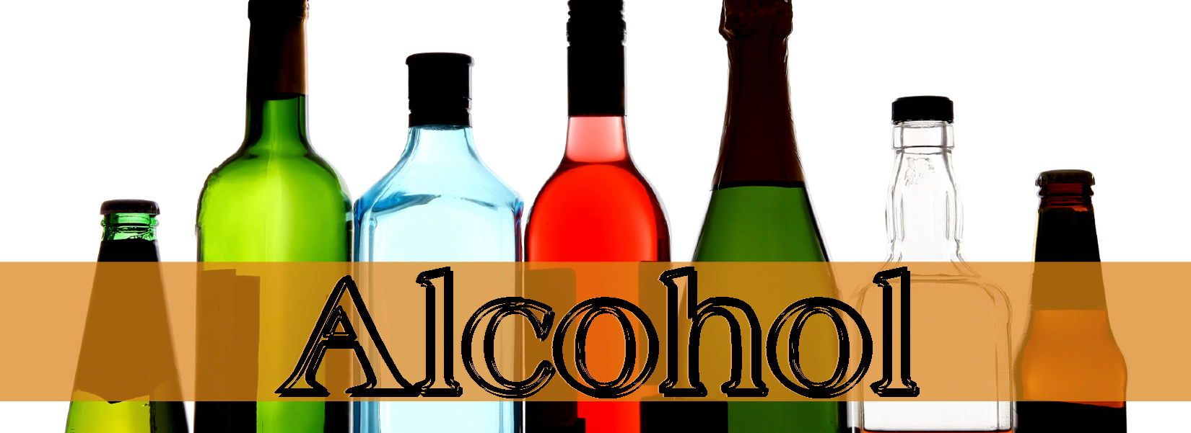
2015
https://www.youtube.com/watch?v=zXjANz9r5F0

Slide 2
Quick write!
“Alcohol is the most commonly used and abused drug among youth in the United States, more than tobacco and illicit drugs, and is responsible for more than 4,300 annual deaths among underage youth.” -CDC.gov
With this information, do feel that alcohol should still be a legal substance? Why or why not?

Slide 3
Objectives for Today!
-Identify effects of alcohol on your body and health
-Recognize signs of alcohol poisoning

Slide 4
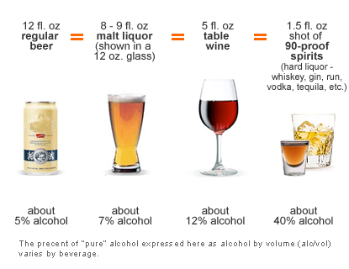
What is Alcohol?
Ethanol or Ethyl -The type of alcohol in alcoholic beverages
Can be produced synthetically or naturally by fermenting fruits and grains

Slide 5
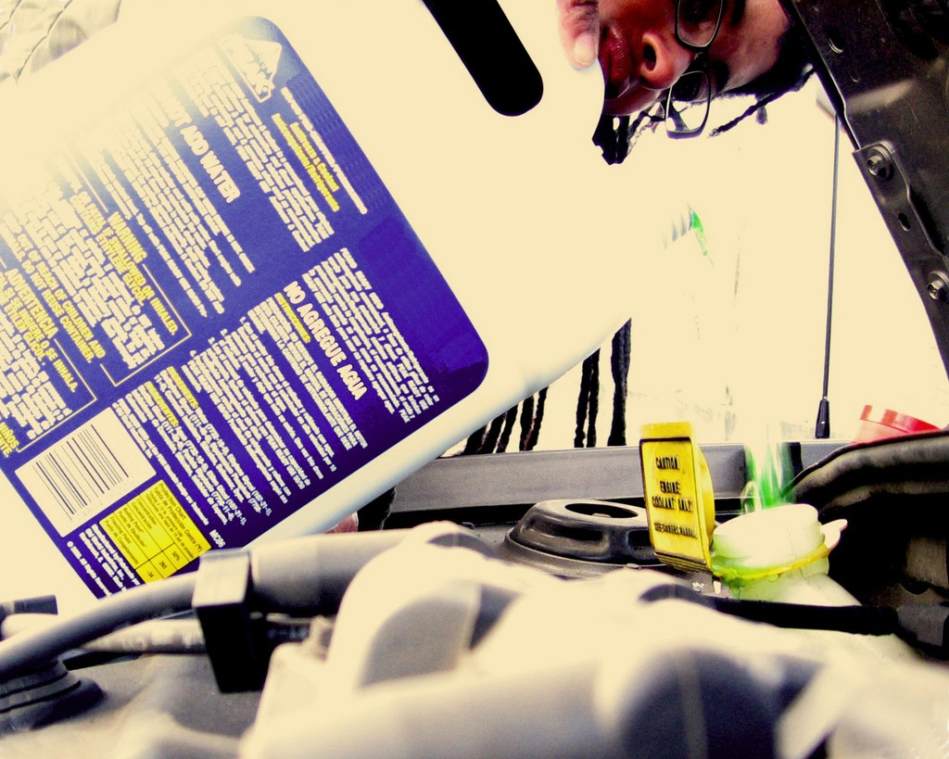
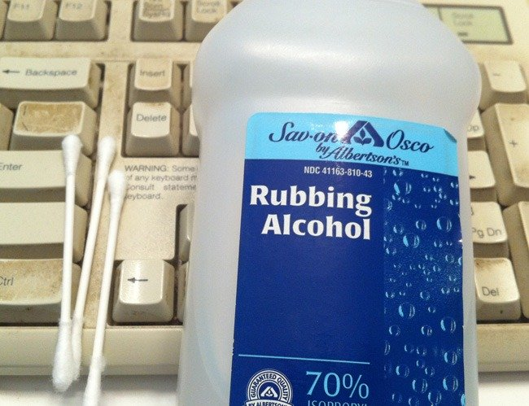
Kinds of Alcohol
Methyl
◦Highly Flammable material
◦Poisonous
Examples are Antifreeze, Wood spirits, fuel, and formaldehyde
Isopropyl
◦Also known as rubbing alcohol
◦Ethyl
◦Form drinking alcohol comes in
◦Safe for drinking, in moderation

Slide 6
What is Alcohol Cont.
An addictive depressant
Causes intoxication- the state in which the body is poisoned by alcohol or other substance
Level of intoxication depend on a variety of things...

Slide 7
BAC—Effects on you…
.02-.03 % BAC: You are slightly light headed; inhibitions are loosened ( Missouri defines .02% as legally drunk for those under 21 years of age).
.05%-.06 BAC: You’re warm and relaxed; you’re behavior may become exaggerated.
.08-.09% BAC: You are legally drunk; you may start to slur your speech, your sense of balance is probably off, and your motor skills are becoming impaired.
.10%-.12% BAC: At this level, you feel euphoric, but you lack coordination and balance; your motor skills are markedly impaired, as are your judgment and memory.
.14%-.17% BAC: Euphoric feelings may give way to unpleasant feelings; you have difficulty talking, walking, or even standing; your judgment and perception are severely impaired.
.20% BAC: You feel confused, dazed, or otherwise disoriented ; at this point you may experience nausea and/or start vomiting; blackouts are likely.
.25% BAC: All mental, physical, and sensory functions are severely impaired; you're at increased risk of asphyxiation from choking on vomit and of seriously injuring yourself by falling or other accidents.
.30% BAC: You have little comprehension of where you are; you may suddenly pass out --with an alarming BAC like .30%, your body will decide to pass out for you.
.35% BAC: This blood alcohol level is the level of surgical anesthesia; you may stop breathing.
.40% BAC: You are probably in a coma. The nerve centers controlling your heartbeat and respiration are slowing down.

Slide 8
Drink Wheel- I need a volunteer
http://www.intox.com/drinkwheel.aspx

Slide 9
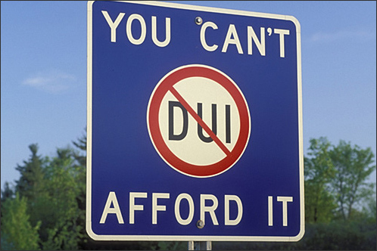
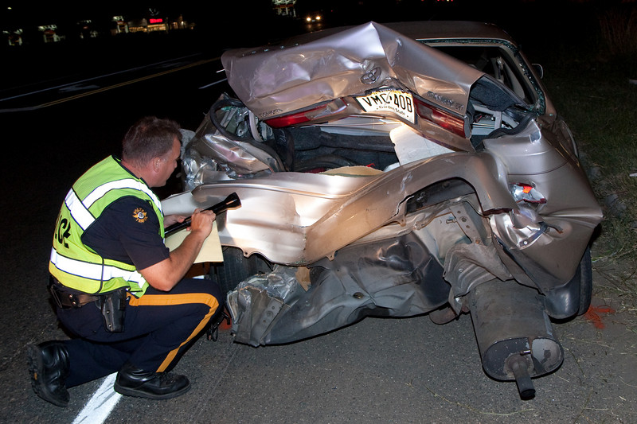
How are you getting home?
Not a Drop! Law
Walking, biking scootering can still be dangerous when intoxicated!
Legal limit- 0.08
http://www.facesofdrunkdriving.com/jacqui

Slide 10
Drinking Age: How & Why it has changed…
21 (1930’s) – Prohibition, The Great Depression
18 (1970’s) - Vietnam
19 (Early 1980’s) – Underage drinking, border jumping, accidents on border
21 (Nat’l Minimum Drinking Age Act of 1984) – MADD, & Insurance companies

Slide 11
Underage Drinking
https://dps.mn.gov/divisions/ots/educational-materials/Documents/Whats-Big-Deal-Brochure.pdf

Slide 12
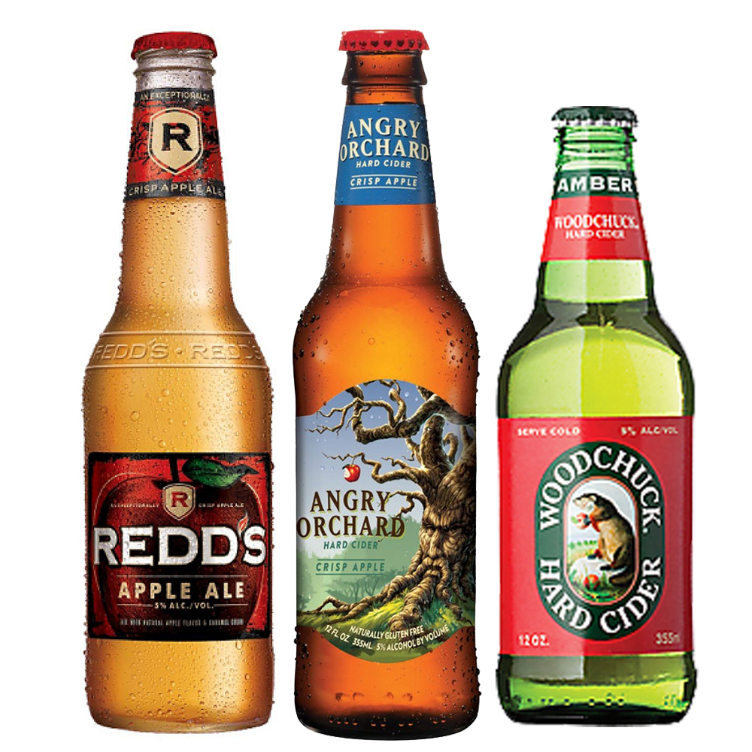
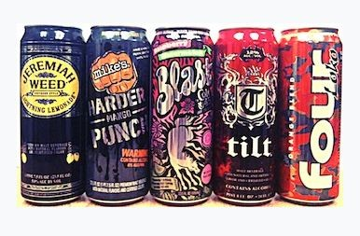
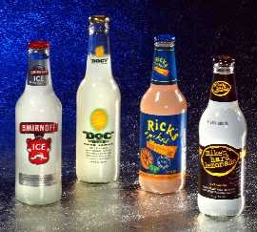
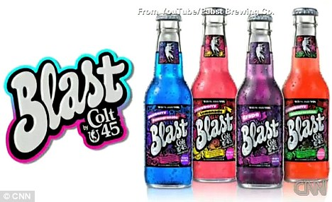
Drinks and Teenagers

Slide 13
Use in Society
Non-users = 10%
Users = 90% (Socially Accepted)
◦Occasional Users = “Social drinking” 10%
◦Moderate Users=Seeking the Mood Swing 45%
◦Heavy Users=Engage in Binge Drinking,Start to rearrange life around alcohol use 35%
◦Chemically Dependent=Experience regular loss of control
Blackouts & Chemical Urgency 10%

Slide 14
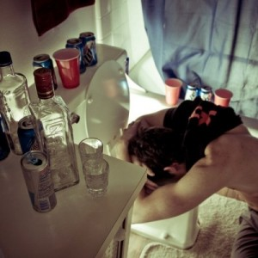
Short Term Effects
Depending on how much is taken and the physical condition of the individual
Slurred speech
Drowsiness
Vomiting
Diarrhea
Upset stomach
Headaches
Breathing difficulties
Distorted vision and hearing
Impaired judgment
Decreased perception and coordination
Unconsciousness
Coma
Blackouts

Slide 15
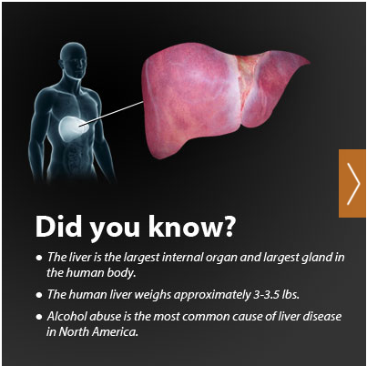
Long Term Effects
Binge drinking and continued alcohol use in large amounts are associated with many health problems, including:
Alcohol poisoning
High blood pressure, stroke, and other heart-related diseases
Liver disease-Cirrhosis
Nerve damage
Increased risk of unprotected sex-STIs
Unplanned pregnancies

Slide 16
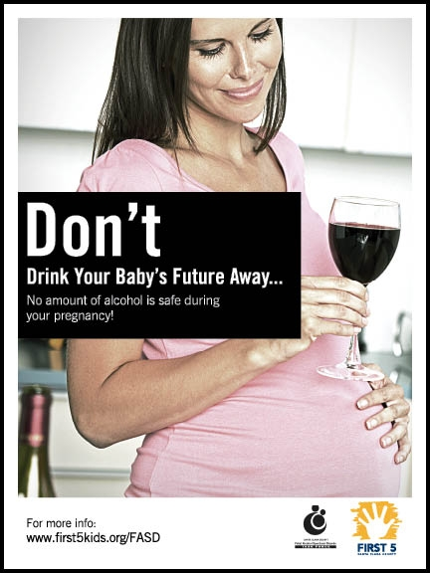
Other Consequences of Drinking
Fetal Alcohol Spectrum Disorders (FASD)
Fetal alcohol syndrome (FAS)
Alcohol-related neurodevelopmental disorder (ARND)
Alcohol-related birth defects (ARBD)
Fetal alcohol effects (FAE)
What do people know?

Slide 17
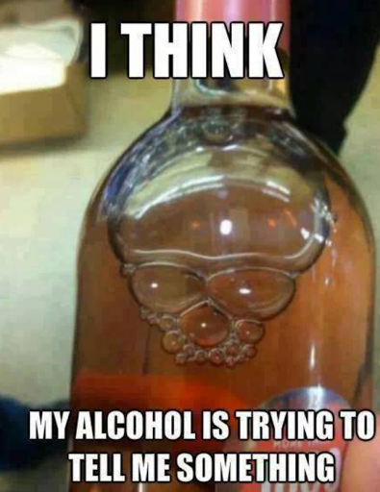
Think, Pair, Share:
Why would things like “drinking games” be problematic?

Slide 18
Binge Drinking
What is it?
The consumption of an excessive amount of alcohol in a short period of time. Generally 5 or more drinks in a row for men, 4 or more for females
How does it affect you?
90% of alcohol consumed by underage persons in the U.S. is in the form of binge drinking.
Alcohol has been said to have positive health consequences when consumed in moderation (About a drink a day).

Slide 19
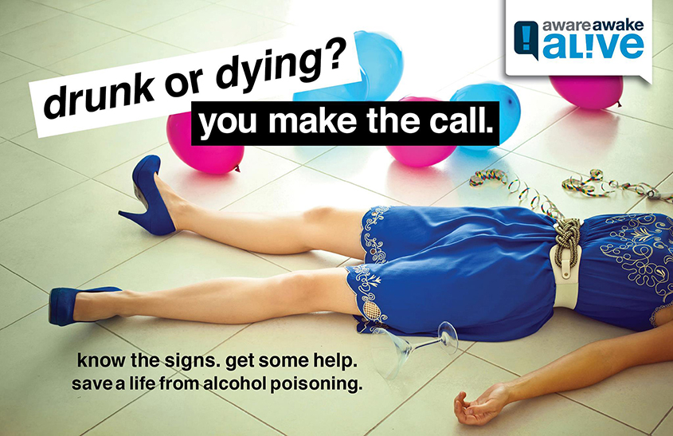
Alcohol Poisoning
Symptoms
Shallow breathing
Disorientation
Unresponsiveness
Unconsciousness
Pale or bluish tone to skin
Vomiting while unconscious
What is Alcohol Poisoning?
A condition in which a toxic amount of alcohol has been consumed, usually in a short period of time.
In other words, the blood alcohol content (BAC) is at a dangerously high level.

Slide 20
What should you do?
Turn the person on their side
Dial 911, get medical help
Stay with the person
http://www.d.umn.edu/hlthserv/health_education/services/alcohol_drugs.html

Slide 21
Addiction and Treatment
4 Levels of the Addiction Process: Addiction
1. Experimentation
2. Regular Use
3. Daily Preoccupation
4. Dependency
Community Resources/Support Groups:
AA (Alcoholics Anonymous)
Al-Anon( for family and friends of alcoholics)
Alateen (just for teenagers)
Teen Challenge(in and out patient treatment center)

Slide 22
Refusal Skills!
Come up with one way to say no to alcohol offered by a friend.

Slide 23
The Truth About Alcohol Video
http://www.drugfreeworld.org/real-life-stories/alcohol.html

